Slide 1


Project Phase-1 Idea Presentation
Green House Automated System For Sustainable Agriculture Using IoT And Machine Learning
Team Members:
Srishreya - 4SF21IS109
Yogesh S Patgar - 4SF21IS125
P Samarth Shenoy - 4SF22IS406
Sujan Acharya - 4SF22IS410
Under the Guidance of:
Mrs. Masooda
Assistant Professor
ISE/ CSE(DS), SCEM
Department of Information Science and Engineering

Slide 2
Contents
Contents
Introduction
Problem Description
Objectives
Proposed Methodology
Scope of the Work
Conclusion

Slide 3
Problem Description
Traditional greenhouse management involves significant manual labor and is prone to human error, leading to suboptimal conditions for plant growth Key challenges include maintaining consistent temperature, humidity, light levels, and soil moisture, which are critical for plant health and yield.
Inefficient use of resources such as water and energy further exacerbates the problem. The lack of real-time monitoring and predictive capabilities often results in delayed responses to environmental changes, adversely affecting crop production.

Slide 4
Objectives
Focused on state-of-the-art IoT-based greenhouse farming applications such as monitoring, controlling predicting, tracking, and sensing
Identify the major challenges and gaps as well as present some future research direction to make IoT technology more robust in greenhouse farming
To develop machine learning models that can predict optimal conditions for plant growth and adjust the greenhouse environment accordingly
Provide a user-friendly interface for farmers to interact with the automated system

Slide 5
Proposed Methodology
System Design:
Sensor Network: Deploy sensors to monitor temperature, humidity, light intensity, and soil moisture.
Actuators: Install devices like fans, heaters, lights, and irrigation systems to control the greenhouse environment.
IoT Platform: Use microcontrollers to collect data from sensors and send it to a central server.
Data Collection and Processing:
Collect real-time data from sensors.
Store data in a cloud-based database for further analysis.

Slide 6
Proposed Methodology
Machine Learning Model Development:
Analyze historical data to identify patterns and correlations.
Develop predictive models to forecast optimal conditions for plant growth.
Implement control algorithms to adjust environmental parameters based on predictions.
Automation and Control:
Integrate the ML models with the IoT platform.
Automate the activation of actuators based on model predictions.
User Interface:
Create a web/mobile application to display real-time data and system status.
Provide control features for manual override and system customization.

Slide 7
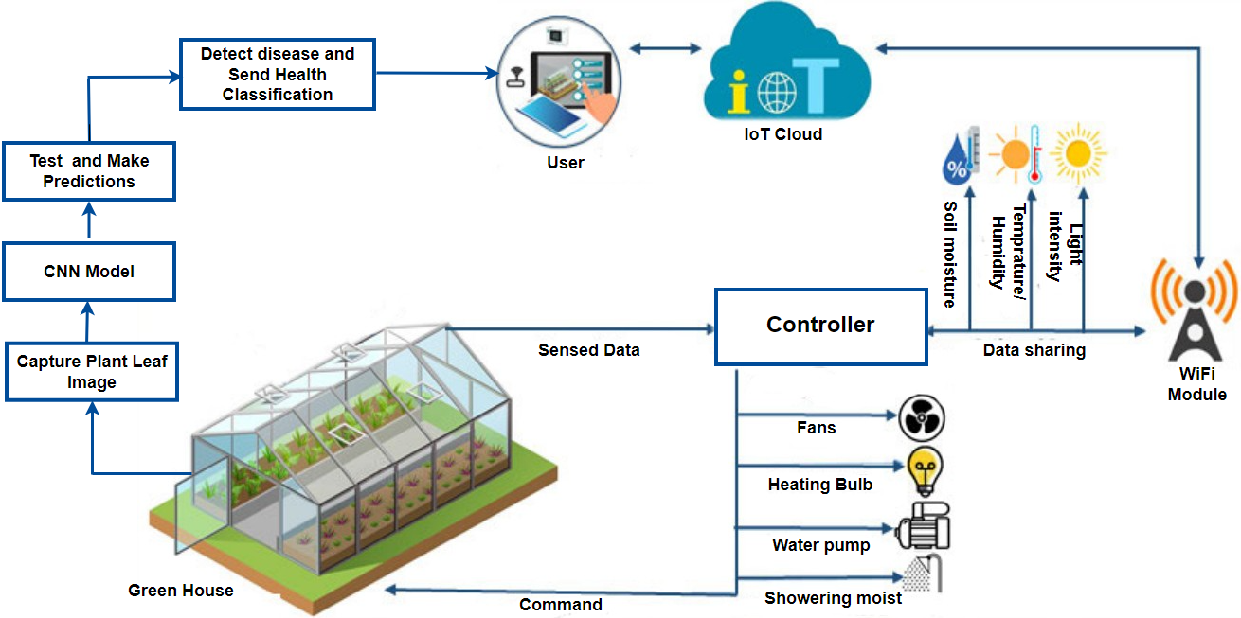
Proposed Methodology
Block diagram of the proposed work

Slide 8
Scope of the Work
System Design and Development: Design the overall architecture of the greenhouse automation system, including hardware and software components
Sensor Network Implementation: Set up a network of IoT sensors and ensure reliable data transmission and storage
Machine Learning Model Development: Develop, train, and validate machine learning models for predictive analysis and optimization of growth conditions
Integration and Testing: Integrate all components and test the system in a controlled greenhouse environment to ensure functionality and reliability
Scalability and Maintenance: Ensure the system is scalable for different sizes of greenhouses and develop a maintenance plan for long-term operation

Slide 9
Conclusion
The Greenhouse Automated System for Sustainable Agriculture using IoT and Machine Learning aims to revolutionize traditional farming practices by leveraging advanced technologies. By integrating IoT sensors, machine learning models, and automated control systems, the proposed solution addresses the inefficiencies of manual farming, promoting sustainable and efficient agricultural practices.
The successful implementation of this system can lead to significant improvements in food production, resource conservation, and overall sustainability in agriculture.

Slide 10
Thank You

